Slide 1
Force Measurement
Force is defined by F = m.a/g_{c} (g_{c} = 1 kg.m/N.s²)
Mass is a fundamental quantity and Acceleration a depends on the standards of two fundamental quantities such as Length and Time.
In case of Weight, a = g. The actual value of g at a given location depends on latitude φ, and also slightly with time. For given h,
With the correction factor for altitude “h” in meters above the MSL is

Slide 2
Basic Methods of Force Measurement
Balancing the unknown force against the known gravitational force directly or through a system of levers
Measuring the acceleration of a body of known mass which is subjected to a unknown force.
Balancing the unknown force against a magnetic force developed by interaction of a current carrying coil and a magnet.
Transmitting the unknown force into a fluid
Measuring the deflection of a elastic member caused by the unknown force
Measuring the change in natural frequency of a wire tensioned by an unknown force.

Slide 3
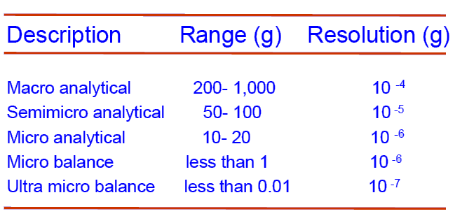
Classification of Balances
Source: E.O.Doebelin, Measurements systems.

Slide 4
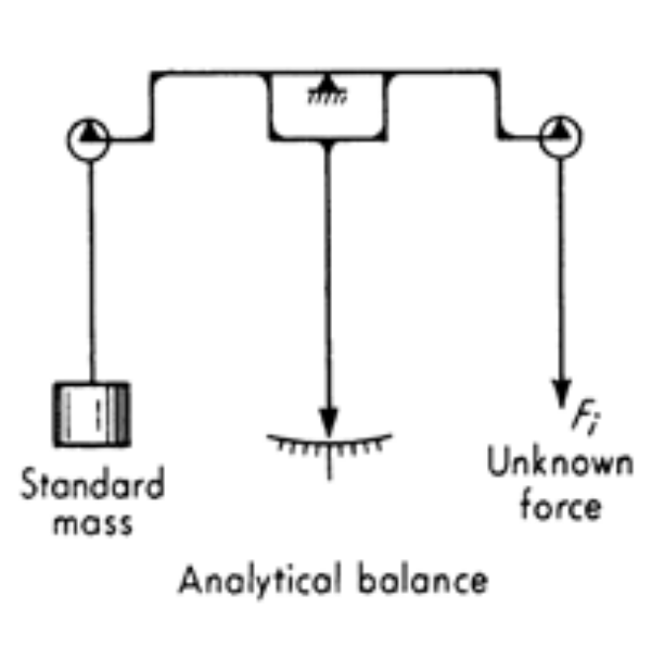
Force Measurement -Balances
Types : Analytical, Pendulum Scale, Platform
Analytical Balance:
Simplest balance
Operates on the principles of moment comparison
The moment produced by the unknown weight or force is compared with that produced by the known weight or force. When null balance is obtained, the two weights are equal provided the arm length are equal.
Careful design : The frame should be designed in such a way that the center of mass is only slightly below the knife edge pivot point ( 50 to 200 μ).
Symmetry of the Frame: Check the arm length by exchanging the known and unknown weights

Slide 5
Force Measurement -Balances
For Better Accuracy:
Buoyancy forces acting on unknown and known weights should be considered.
Due to immersion of mass in air.
If the measurement is carried out in vacuum the effect of buoyancy forces is negligible.
2. Measurement should be taken place in a controlled temperature chamber. Especially for micro scale measurement.

Slide 6

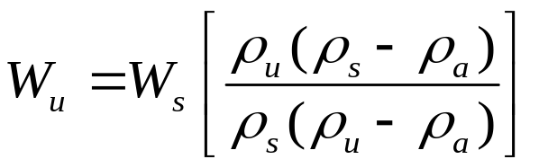
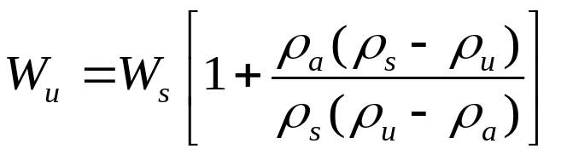
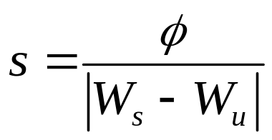
Effect of Buoyancy Force on the Weight Measurement
The two forces exerted on the balance arms are given by
Where the suffice u, s and a represents that for the unknown sample, standard sample and air, respectively .
Neglecting Buoyancy effects, the true weights of the unknown and standard are
Buoyancy effect will be more significant for lesser density materials.
At null deflection, W₁ = W₂
(or)
Sensitivity of the balance,
where, φ = beam deflection in radians

Slide 7
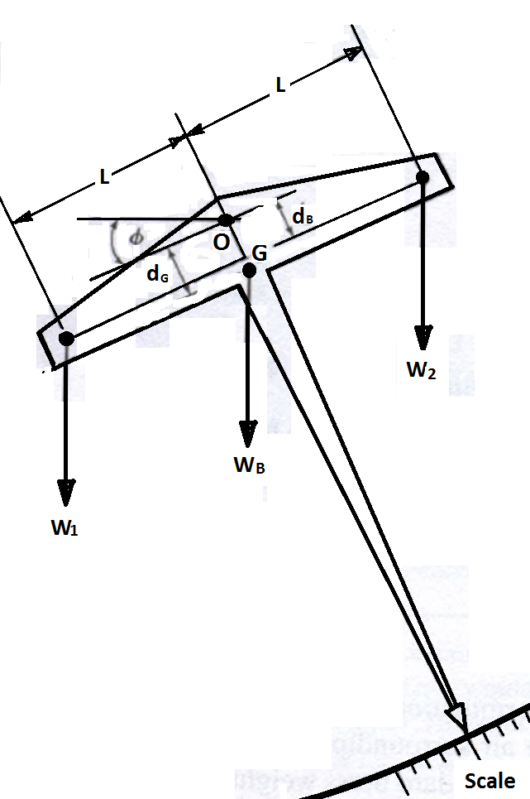
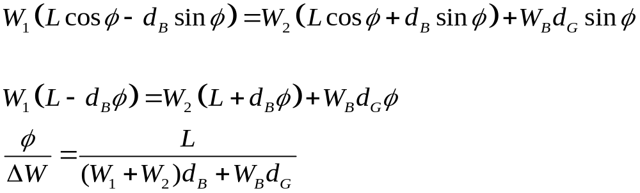
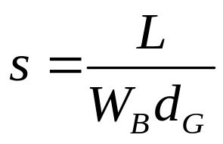
If the fulcrum is constructed so that dB 0, then

Slide 8
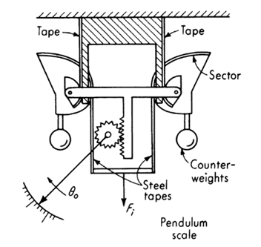
Pendulum Balance
Deflection type Instrument.
Unknown force is converted to a torque that is then balanced by the torque of a fixed standard mass(pendulum).
Specially shaped sectors and steel tapes linearize the non-linear torque-angle relation of a pendulum.

Slide 9
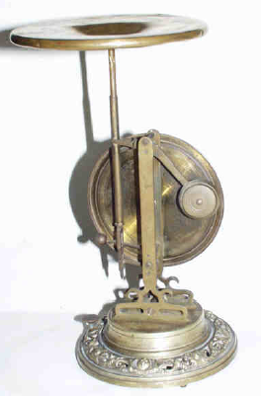
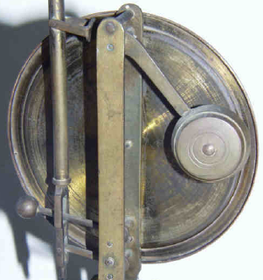
Old Pendulum type Balance

Slide 10
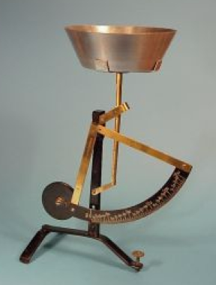
Old-fashioned
Pendulum Balance
(For small range of force measurement)

Slide 11
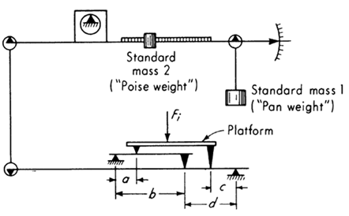
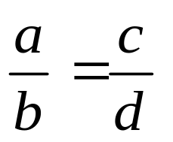
Platform Balance
Moments of unknown force is balanced using a system of levers and standard mass combination.
System is made Null by a proper combination of weights and lever arm lengths.
3. Measurement of large forces in terms of much smaller weights.
4. Reading of the scale is independent of the location of force F_{i} on the platform if

Slide 12
Electromagnetic Balance
Electromagnetic force to balance the unknown force
Used in deflection and null models
Easy to handle, compact
Less sensitivity to the environmental change
Fast response, can be used for dynamic force measurements
Electrical signal is very convenient for continuous recording and automatic control of process.
Balance with built in microprocessor also is available
Automatic tare-weight systems available for net weight requirements.

Slide 13
Load Cells
Hydraulic and Pneumatic types
Hydraulic cell uses an incompressible oil
Cell cavity initially preloaded with oil around 2 bar
Application of load increases the oil pressure, which is read on an accurate pressure gauge or Transducer
Cells are very stiff, deflections only a few thousands of an inch
Capacities up to about 5000 tonnes
Accuracy up to ± 1% of FS.
Temperature sensitivity unto ± 0.25 % for 10ºF

Slide 14
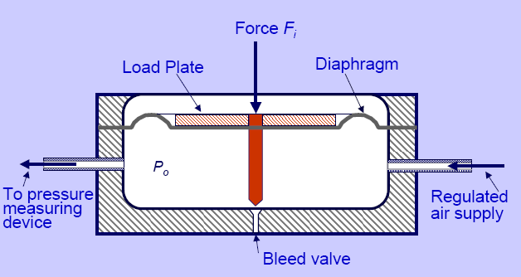
Pneumatic Load Cells
Application of force F_{i} causes the diaphragm deflection which in turn causes an increase in pressure p_{o}
Increasing the pressure acting on the diaphragm produces an effective force F_{p} that tends to return the diaphragm to its initial position.
Pressure under the diaphragm is controlled by both changing the supply pressure and position of bleed valve.
A typical supply pressure P_{s} is about 4 bar and the maximum value of P_{o} can not exceed P_{s}, this limits Fi to somewhat less than 400 A kN (A= area of diaphragm, in m²).
P_{o}
Capacity up to about 50,000 tonnes
P_{s}

Slide 15



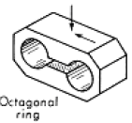
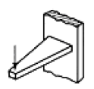
Elastic Load Cells
Elastic load cells are widely used for both static and dynamic force measurements ( Frequency about 100 Hz.)
All are spring and mass systems
Strain gages may be located to sense the force in terms of strain.
Designed for specific directions.
Load cells are tailored depends on the applications, load magnitude, nature for the force, etc.
Source: E.O.Doebelin, Measurements systems.

Slide 16
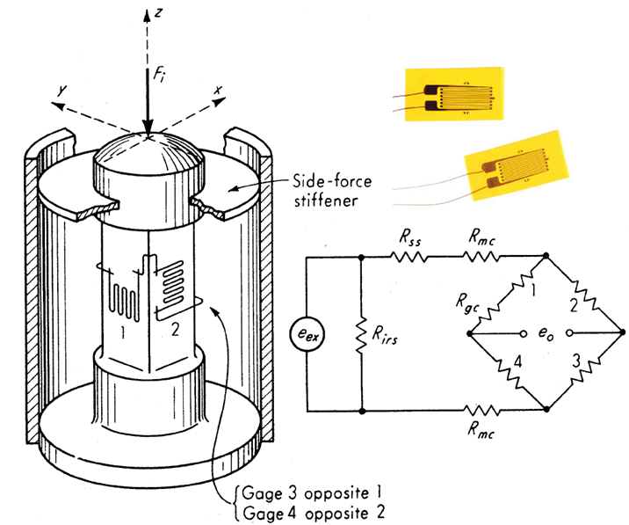
Bounded Stain gage Transducers
Four strain gages are employed (refer figure). They should be placed symmetric.
To achieve high accuracy, additional temperature compensation resistors are used. Further, additional resistors may also be used for adjusting the input resistance and sensitivity.
1,3 direct strain and 2,4 transverse strain
Deflection under full load will be in the order of 0.001 to 0.015 in
Material used SS – 4340, SS-17-4 PH, 2024-T4 aluminum alloy, etc.

Slide 17
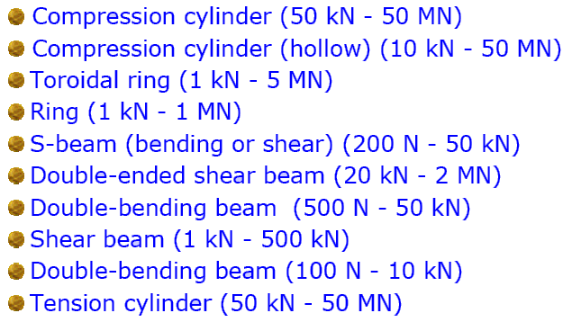
When maximum output is desired, Use low modulus materials (e.g. Al)
However, Low modulus usually reduces stiffness leading to excessive hysteresis, low fatigue life, etc.
Different types of load cells and their ranges

Slide 18
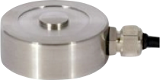
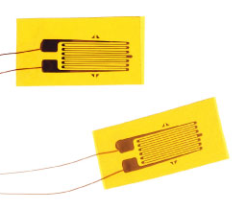
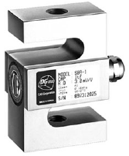
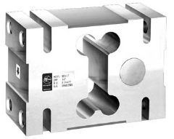
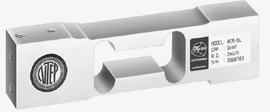
Commercially available load cells

Slide 19
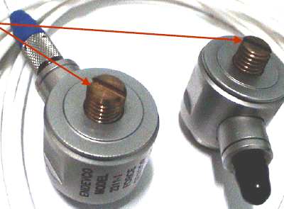
Piezoelectric load cells
Mainly used for dynamic force measurement.
Cell with large time constant may be used for short term static force.
Mounting Screws

Slide 20
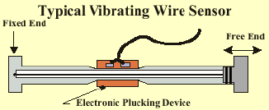
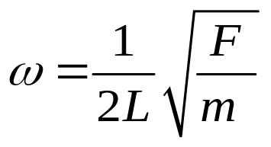
Vibrating Wire Transducers
First natural frequency ω of a string of length L and mass per unit length m, which is tensioned by the force F to be measured
Frequency is measured and then it is related to the applied force. Frequency is measured by conventional digital counters.

Slide 21
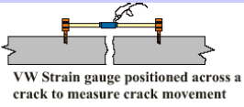
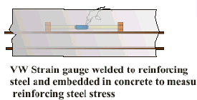
Wires are thin electrically conducting metals placed in the fields of permanent magnets.
Temperature sensitivity ( tension of the wire changes with temperature)
Non – Linear relation
Vibrating Wire Transducer Applications
Embedded in concrete to measure reinforcing steel stress
Underwater crack movement
Joint movement between two structural members
Minute rotational movement of structural members

Slide 22
Plastic Deformation Method
Records the Plastic deformation of the sample which is being subjected to an applied force.
The deformation for a particular size, shape and material properties may be calibrated by testing of similar elements.
Magneto Elastic Force Transducer
When a ferromagnetic material is subjected to mechanical force, the magnetic properties of the material are altered and the change is proportional to the applied force.
The magneto-elastic load cell can be used in rough and electrically disturbed environments such as in rolling mills.
Ranges are 2 KN – 5 MN.

Slide 23
Optical Strain Gages
Formed similar to resistance strain gages using optical fibers instead of wires / foils.
If monochromatic light passes through two optical strain gages experiencing different strain levels, the phase difference between them is the measure of applied force.

Slide 24
Resolving forces and moments
To test aircraft and rocket engine
Major objects is to resolve three components of forces and moments resulting from the engine thrust.
Wind tunnel balance
For measuring forces on wind tunnel model
Lathe and other machines
For resolving cutting forces in lathe tool machines

Slide 25
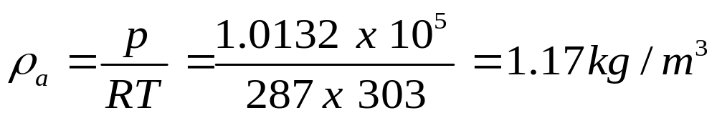
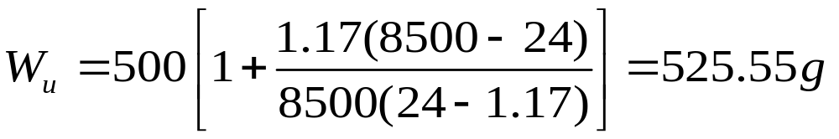
Illustrative Example
A quantity of a light weight insulating material having a density of about 24 kg/m³ is weighed on a standard equal –arm balance. Balance conditions are archived with MS weights totaling 500 g at a ambient temperature of about 30ºC. The density of MS may be taken as 8500 kg/m³. Calculate the true weight of the insulating material and percentage of error caused due to the buoyancy effect.
Solution
The density of the air at 30ºC is
True weight is given by
Error in the measurement = 5.1%

Slide 26
